Slide 1
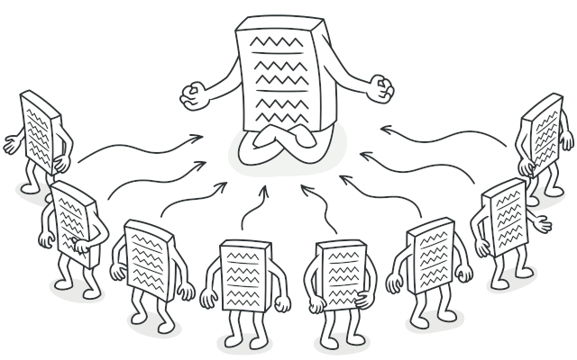
Singleton Pattern 2021-SE-06 Muhammad Hashim

Slide 2
Singleton Pattern 2021-SE-06 Muhammad Hashim

Slide 3


Pattern Type: Creational
This pattern deals with object creation
mechanisms, trying to create objects in a
manner suitable to the situation

Slide 4

Problem
Ensuring that a class has only one instance.
Global resource such as Database.
Controlling access to a shared resource.
Avoiding unnecessary object creation.
Reduce memory usage and improve performance.

Slide 5
Usage:
Ensure that a class has just a single instance
Provide a global access point to that instance.

Slide 6
Benefits:
When you want to ensure that a class has only one instance and provides a global point of access to that instance.
When you need to control access to shared resources, like configuration settings or a connection pool.
When you need to prevent multiple instances of a class due to resource constraints.

Slide 7
Solution:
public class Singleton {
private static Singleton instance;
private Singleton() {
// Prevent instantiation from outside the class
}
public static Singleton getInstance() {
if (instance == null) {
instance = new Singleton();
}
return instance;
}
}

Slide 8
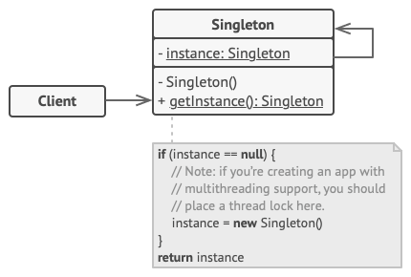
UML Diagram

Slide 9
Thank you

